Slide 1
Green Sign Segmentation

Slide 2
Model Description
Architecture: UNET
Loss Function: Dice Loss + BCE Loss Combined
Optimizer: Adam
Threshold Optimizer: Bayesian
Hyperparameters
Learning Rate | Weight Decay | Momentum | Number Of Epochs | Learning Rate Patience | Early Stop Patience | Batch Size for Training
1e-5 | 1e-8 | 0.9 | 100 | 5 | 10 | 8

Slide 3
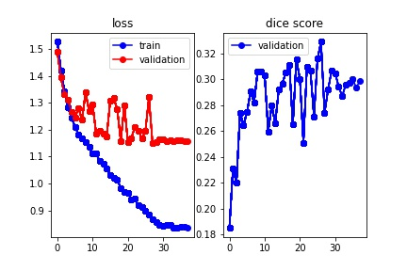
Graphs and Results (UNET + Dice BCE + Adam)
Dice Score on Validation set : 0.3290
Jaccard Score on Validation set: 0.3649
Jaccard Score on Validation set ( with original resolution ) : 0.3899

Slide 4
Model Description
Architecture: UNET
Loss Function: Dice Loss
Optimizer: Adam
Threshold Optimizer: Bayesian
Hyperparameters
Learning Rate | Weight Decay | Momentum | Number Of Epochs | Learning Rate Patience | Early Stop Patience | Batch Size for Training
1e-5 | 1e-8 | 0.9 | 100 | 5 | 10 | 8

Slide 5
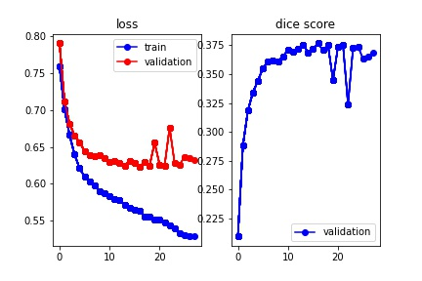
Graphs and Results (UNET + Dice + Adam)
Dice Score on Validation set : 0.3766
Jaccard Score on Validation set: 0.3923
Jaccard Score on Validation set ( with original resolution ) : 0.4

Slide 6
Model Description (UNET + IOU + Adam)
Architecture: UNET
Loss Function: IOU Loss
Optimizer: Adam
Threshold Optimizer: Bayesian
Hyperparameters
Learning Rate | Weight Decay | Momentum | Number Of Epochs | Learning Rate Patience | Early Stop Patience | Batch Size for Training
1e-5 | 1e-8 | 0.9 | 100 | 5 | 10 | 8

Slide 7
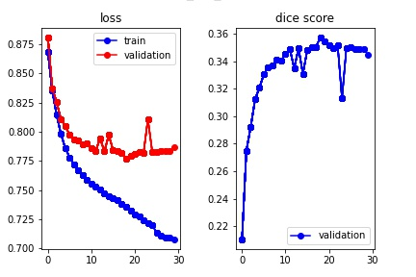
Graphs and Results (UNET + IOU + Adam)
Dice Score on Validation set : 0.3570
Jaccard Score on Validation set: 0.4005
Jaccard Score on Validation set ( with original resolution ) : 0.4152

Slide 8
Model Description
Architecture: UNET with extra layer
Loss Function: Dice Loss + BCE Loss Combined
Optimizer: Adam
Threshold Optimizer: Bayesian
Hyperparameters
Learning Rate | Weight Decay | Momentum | Number Of Epochs | Learning Rate Patience | Early Stop Patience | Batch Size for Training
1e-5 | 1e-8 | 0.9 | 100 | 5 | 10 | 8

Slide 9
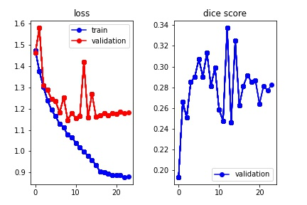
Graphs and Results (UNET + Dice BCE + Adam)
Dice Score on Validation set : 0.3374
Jaccard Score on Validation set: 0.3898
Jaccard Score on Validation set ( with original resolution ) : 0.4008

Slide 10
Model Description
Architecture: UNET with extra layer
Loss Function: Dice Loss
Optimizer: Adam
Threshold Optimizer: Bayesian
Hyperparameters
Learning Rate | Weight Decay | Momentum | Number Of Epochs | Learning Rate Patience | Early Stop Patience | Batch Size for Training
1e-5 | 1e-8 | 0.9 | 100 | 5 | 10 | 8

Slide 11
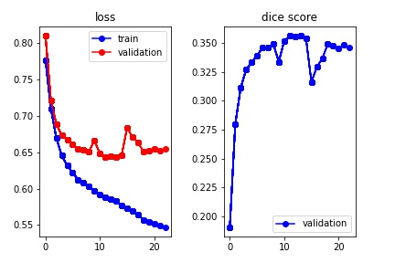
Graphs and Results (UNET + Dice + Adam)
Dice Score on Validation set : 0.3564
Jaccard Score on Validation set: 0.4043
Jaccard Score on Validation set ( with original resolution ) : 0.4206

Slide 12
Model Description (UNET + IOU + Adam)
Architecture: UNET with extra layer
Loss Function: IOU Loss
Optimizer: Adam
Threshold Optimizer: Bayesian
Hyperparameters
Learning Rate | Weight Decay | Momentum | Number Of Epochs | Learning Rate Patience | Early Stop Patience | Batch Size for Training
1e-5 | 1e-8 | 0.9 | 100 | 5 | 10 | 8

Slide 13
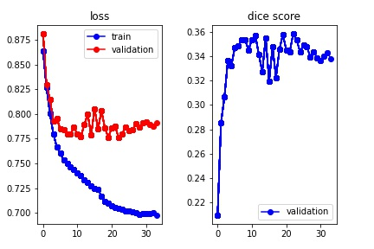
Graphs and Results (UNET + IOU + Adam)
Dice Score on Validation set : 0.3586
Jaccard Score on Validation set: 0.3985
Jaccard Score on Validation set ( with original resolution ) : 0.4150

Slide 14
With Data Augmentation
After Data Augmentation, the size of the new dataset:
311*5 + 311 =1,866 images
311*5 + 311 =1,866 masks

